Slide 1
DQM Retail & Commercial Customer
UI and US comments
Presentation to XXX
DD.MM.YY
Internal

Slide 2
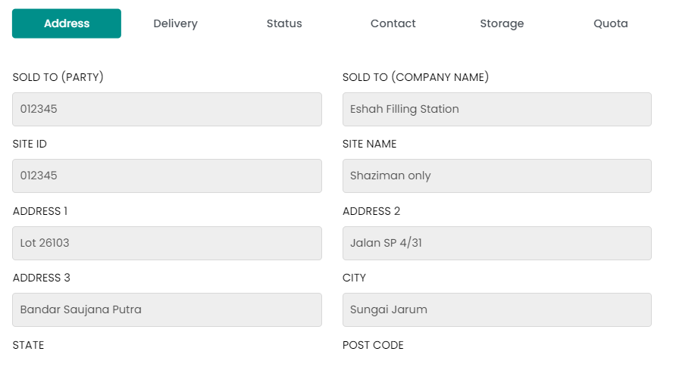
COMMERCIAL CUSTOMER
No. | Sub Features | Issue Descriptions | Category of Issue | Solution Proposed | PIC | Deadline | Status
1. | Pop-up - Address | SITE ID and SITE NAME needs to be removed | UI | Remove SITE ID and SITE NAME |  |  | YET TO START
Remove SITE ID and SITE NAME

Slide 3
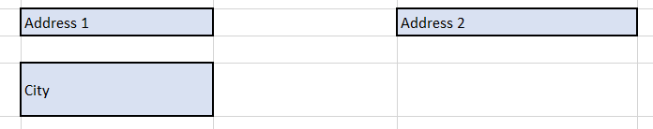
COMMERCIAL CUSTOMER
No. | Sub Features | Issue Descriptions | Category of Issue | Solution Proposed | PIC | Deadline | Status
2. | Pop-up - Address | Distance from terminal needs to be removed and speed moved to replace | UI | Remove distance from terminal and move speed to the left under cloud |  |  | YET TO START
Remove from screen
Move to Adress 3 space. Should be under Address 1

Slide 4
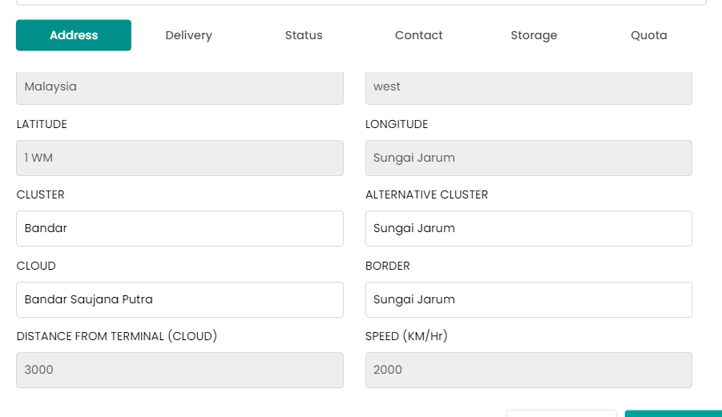
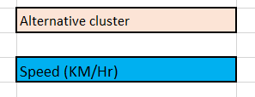
COMMERCIAL CUSTOMER
No. | Sub Features | Issue Descriptions | Category of Issue | Solution Proposed | PIC | Deadline | Status
3. | Pop-up - Address | Distance from terminal needs to be removed and speed moved to replace | UI | Remove distance from terminal and move speed to the left under cloud |  |  | YET TO START
Remove from screen
Move to Border space. Should be under ALTERNATIVE CLUSTER

Slide 5
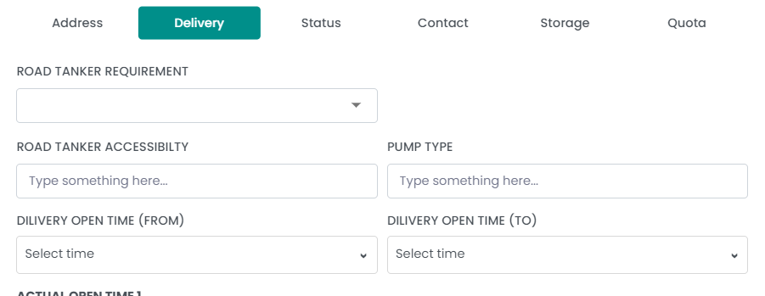
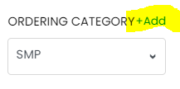
COMMERCIAL CUSTOMER
No. | Sub Features | Issue Descriptions | Category of Issue | Solution Proposed | PIC | Deadline | Status
4. | Pop-up - Delivery | RT Requirement dropdown needs to be amendable | UI | Add option for user to add dropdown |  |  | YET TO START
Add ability for user to add dropdown option

Slide 6
COMMERCIAL CUSTOMER
No. | Sub Features | Issue Descriptions | Category of Issue | Solution Proposed | PIC | Deadline | Status
5. | Pop-up - Delivery | RT Accessibility and Pump Type comes from SAP and cannot be amended | UI | Grey out field. User cannot amend and the data needs to come from SAP |  |  | YET TO START
From SAP, DQM Master cannot amend, needs to be greyed out

Slide 7
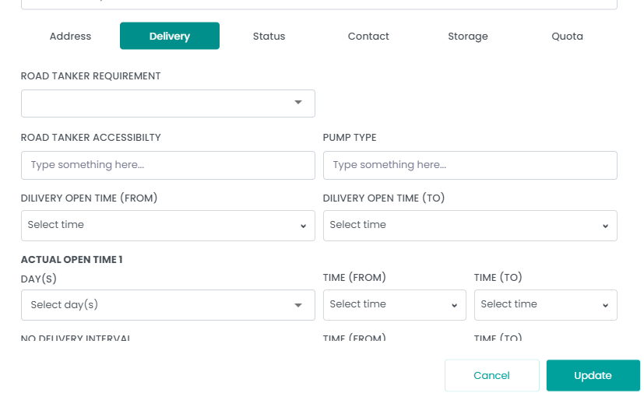
COMMERCIAL CUSTOMER
No. | Sub Features | Issue Descriptions | Category of Issue | Solution Proposed | PIC | Deadline | Status
6. | Pop-up - Delivery | Spelling error for DELIVERY Delivery Open time comes from SAP and is not amendable | UI | 1. Correct spelling error 2. Grey out field. User cannot amend and the data needs to come from SAP |  |  | YET TO START
Change to DELIVERY OPEN TIME (FROM) and DELIVERY OPEN TIME (TO)
From SAP, DQM Master cannot amend, needs to be greyed out

Slide 8
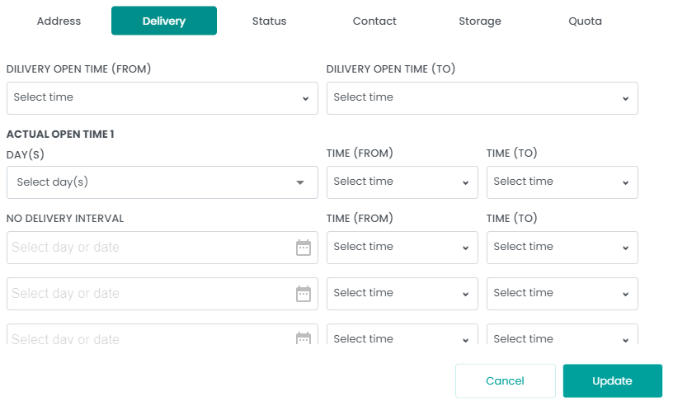
COMMERCIAL CUSTOMER
No. | Sub Features | Issue Descriptions | Category of Issue | Solution Proposed | PIC | Deadline | Status
7. | Pop-up - Delivery | Insufficient time dropdown for Actual Open Time | UI | Add 23:59 to every time dropdown |  |  | YET TO START
Add 23:59 to each time dropdown

Slide 9
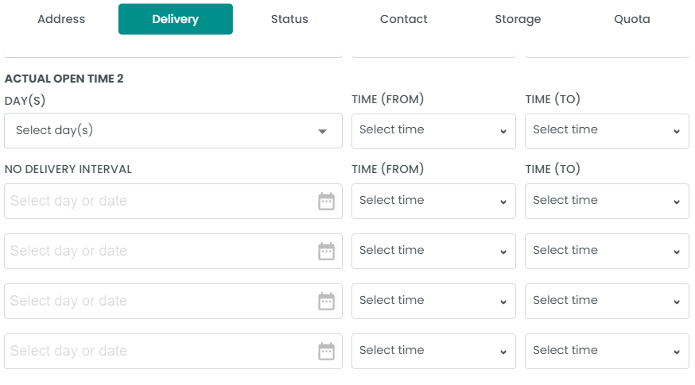
COMMERCIAL CUSTOMER
No. | Sub Features | Issue Descriptions | Category of Issue | Solution Proposed | PIC | Deadline | Status
8. | Pop-up - Delivery | No delivery Interval needs to have 5 rows | UI | Add another row to No delivery Intervel |  |  | YET TO START
Only 4 rows available, need 5. Add one more

Slide 10
COMMERCIAL CUSTOMER
No. | Sub Features | Issue Descriptions | Category of Issue | Solution Proposed | PIC | Deadline | Status
9. | Pop-up - Delivery | No delivery Interval 1 &2 needs to be hardcoded to all days No delivery interval 1&2 time from and to comes from SAP | UI | Hardcode to Daily Grey out field. User cannot amend and the data needs to come from SAP |  |  | YET TO START
Cannot be changed in AWSM, need to hardcode to Daily
From SAP, DQM Master cannot amend, needs to be greyed out

Slide 11
COMMERCIAL CUSTOMER
No. | Sub Features | Issue Descriptions | Category of Issue | Solution Proposed | PIC | Deadline | Status
10. | Pop-up - Delivery | Insufficient time dropdown for No delivery Interval | UI | Add 23:59 to every time dropdown |  |  | YET TO START
Add 23:59 to each time dropdown

Slide 12
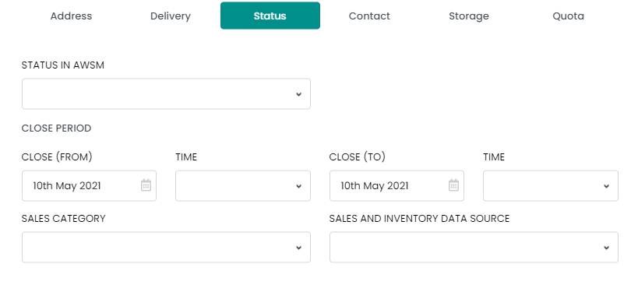
COMMERCIAL CUSTOMER
No. | Sub Features | Issue Descriptions | Category of Issue | Solution Proposed | PIC | Deadline | Status
11. | Pop-up - Status | Status in AWSM dropdown is inaccurate Add logic based on SAP Add logic based on user entry | UI | Amend dropdown If Active in SAP, default ACTIVE in AWSM. If INACTIVE in SAP, default INACTIVE in AWSM, close period disabled If user choose Temporarily Closed, then close period will be mandatory |  |  | YET TO START
Dropdown should be
Active
Temporarily Closed
Inactive
If AWSM Status is
ACTIVE/INACTIVE = CLOSE PERIOD DISABLED grey out
TEMPORARILY CLOSED = All fields mandatory with adding * red

Slide 13
COMMERCIAL CUSTOMER
No. | Sub Features | Issue Descriptions | Category of Issue | Solution Proposed | PIC | Deadline | Status
12. | Pop-up - Status | Remove Sales Category Move Sales and Inventory data source position | UI | Remove Sales Category Sales and Inventory data source |  |  | YET TO START
Move up, follow retail customer
REMOVE Field

Slide 14
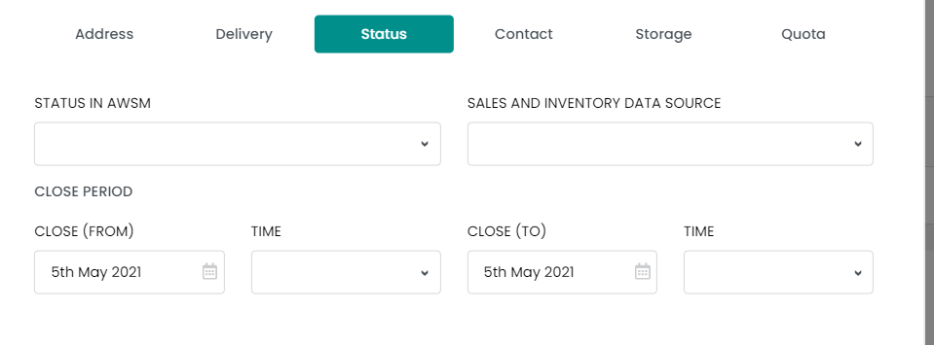
COMMERCIAL CUSTOMER
No. | Sub Features | Issue Descriptions | Category of Issue | Solution Proposed | PIC | Deadline | Status
13. | Pop-up - Status | Sales and Inventory data source dropdown is amendable | UI | Add option for user to add dropdown |  |  | YET TO START
Add ability for user to add dropdown option (MOVE FIELD UP FIRST)

Slide 15
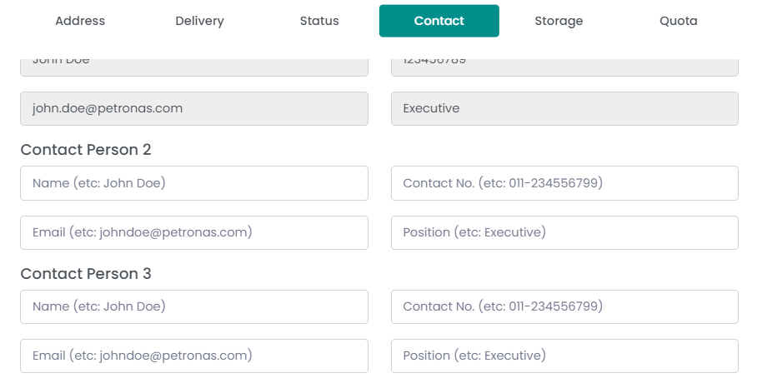
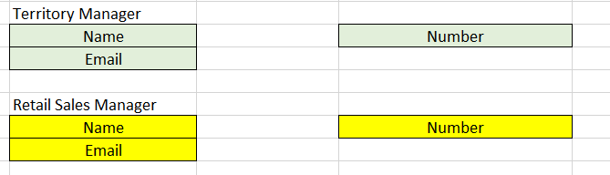
COMMERCIAL CUSTOMER
No. | Sub Features | Issue Descriptions | Category of Issue | Solution Proposed | PIC | Deadline | Status
14. | Pop-up - Contact | TM and RS details missing | UI | Add TM and RS info as screenshot |  |  | YET TO START
Missing TM (from SAP) and RS (manual data entry) info
Territory Manager
Should be disabled

Slide 16
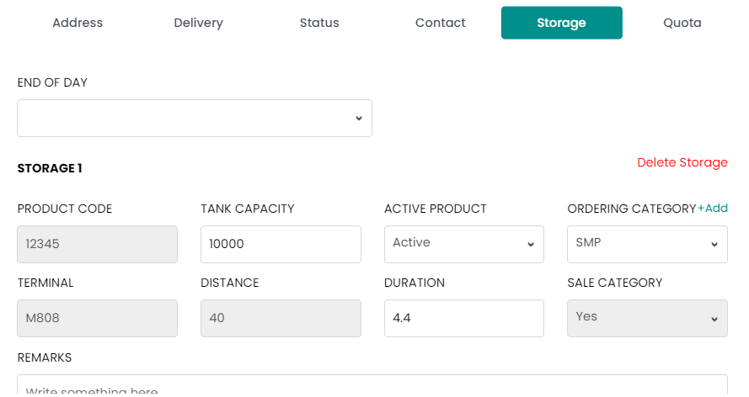
COMMERCIAL CUSTOMER
No. | Sub Features | Issue Descriptions | Category of Issue | Solution Proposed | PIC | Deadline | Status
15. | Pop-up - Storage | Insufficient time dropdown for End of Day | UI | Add 23:59 to every time dropdown |  |  | YET TO START
Add 23:59 to dropdown

Slide 17
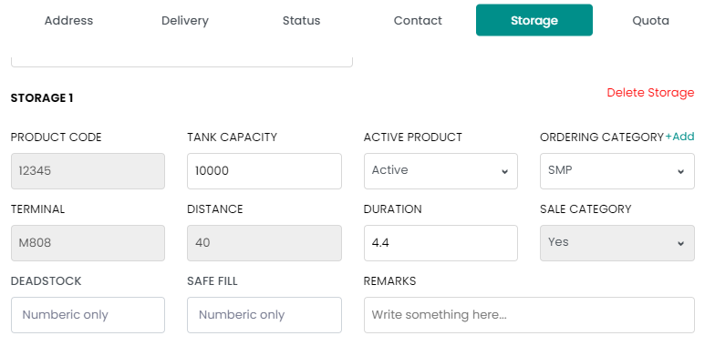
COMMERCIAL CUSTOMER
No. | Sub Features | Issue Descriptions | Category of Issue | Solution Proposed | PIC | Deadline | Status
16. | Pop-up - Storage | All details should be amendable | UI | Make all fields amendable for DWM Master |  |  | YET TO START
All should be amendable

Slide 18
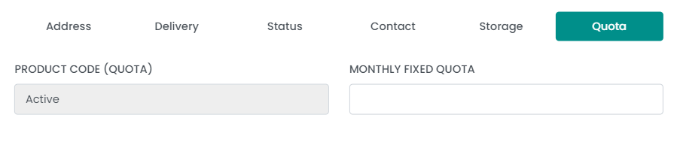
COMMERCIAL CUSTOMER
No. | Sub Features | Issue Descriptions | Category of Issue | Solution Proposed | PIC | Deadline | Status
17. | Pop-up - Storage | Number of rows of product code does not follow Storage Tab | UI | There needs to be a link between number of product in storage and in quota tabs |  |  | YET TO START
Number of rows is added or removed automatically as user amends product number in storage tab
Remove (QUOTA) from label

Slide 19
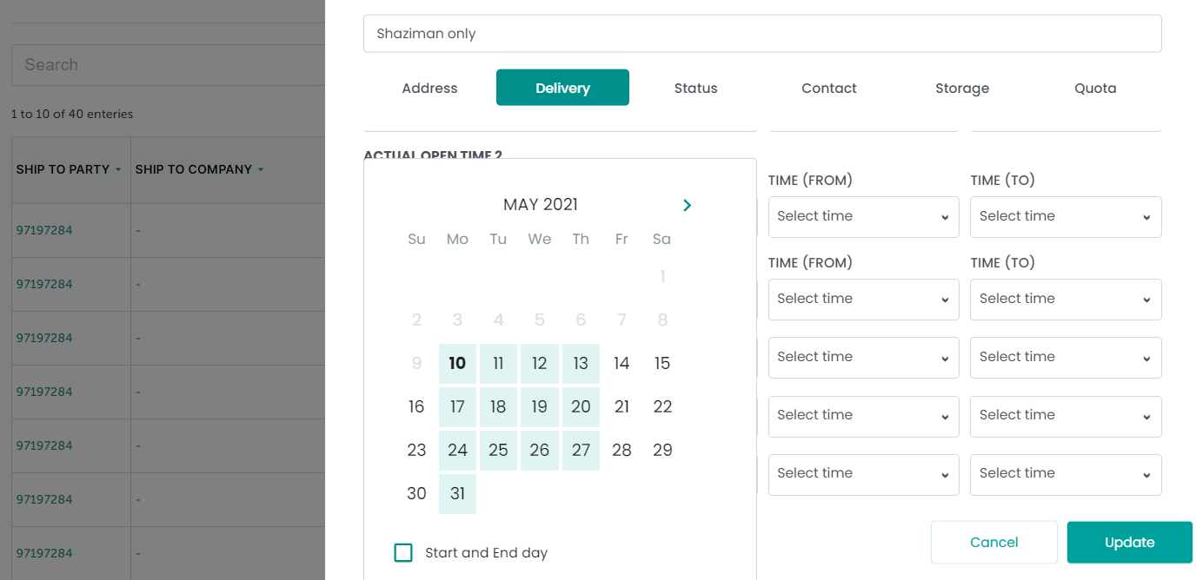
COMMERCIAL CUSTOMER
No. | Sub Features | Issue Descriptions | Category of Issue | Solution Proposed | PIC | Deadline | Status
18. | Pop-up - Delivery | Days chosen not highlighted | UI | Highlight the days chosen by user |  |  | YET TO START
Highlight the chosen days

Slide 20
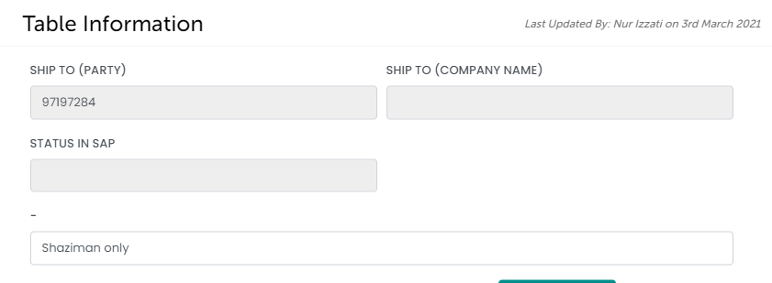
COMMERCIAL CUSTOMER
No. | Sub Features | Issue Descriptions | Category of Issue | Solution Proposed | PIC | Deadline | Status
19. | Pop-up – Static at top | Wrong remarks field name | UI | Change the field name to REMARKS |  |  | YET TO START
Change to REMARKS

Slide 21
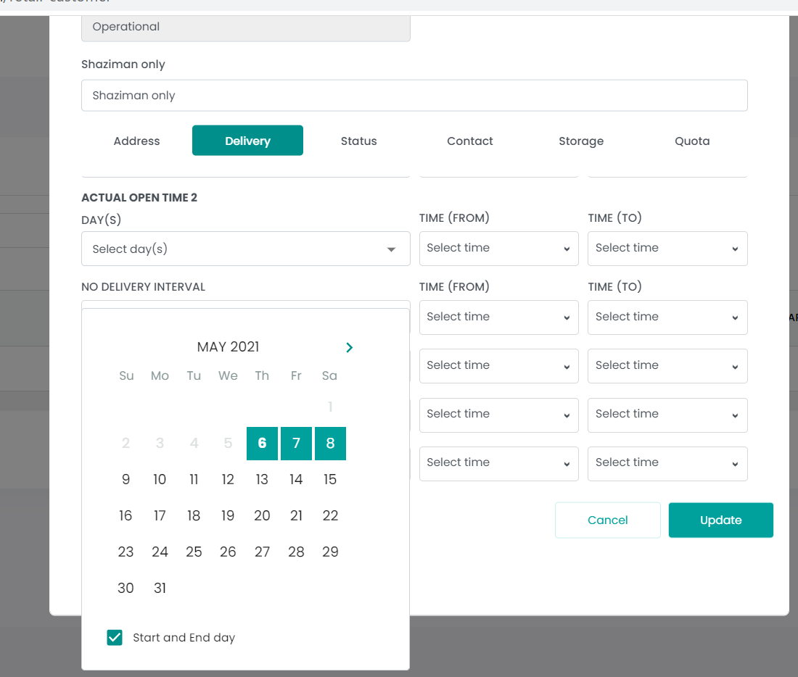
COMMERCIAL CUSTOMER
No. | Sub Features | Issue Descriptions | Category of Issue | Solution Proposed | PIC | Deadline | Status
20. | Pop-up - Delivery | Apply and clear button not available for No delivery interval | UI | Add ‘APPLY’ and ‘CLEAR’ button to calendar dropdown |  |  | YET TO START
Add ‘APPLY’ and ‘CLEAR’ button

Slide 22
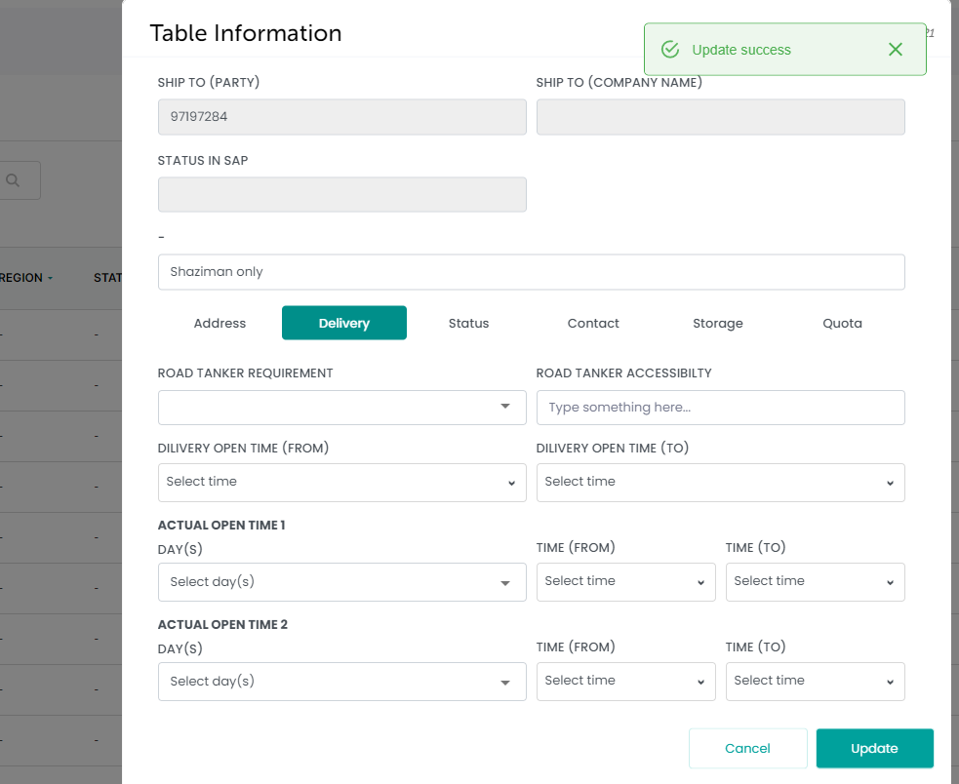
COMMERCIAL CUSTOMER
No. | Sub Features | Issue Descriptions | Category of Issue | Solution Proposed | PIC | Deadline | Status
21. | Pop-up - Update | Pop-up screen doesn’t exit after user clicks on ‘UPDATE’ | UI | Pop-up needs to exit after ‘Update success’ notification appears |  |  | YET TO START
The pop-up screen should exit after user clicks update

Slide 23
Ui Feedbacks & Comments

Slide 24
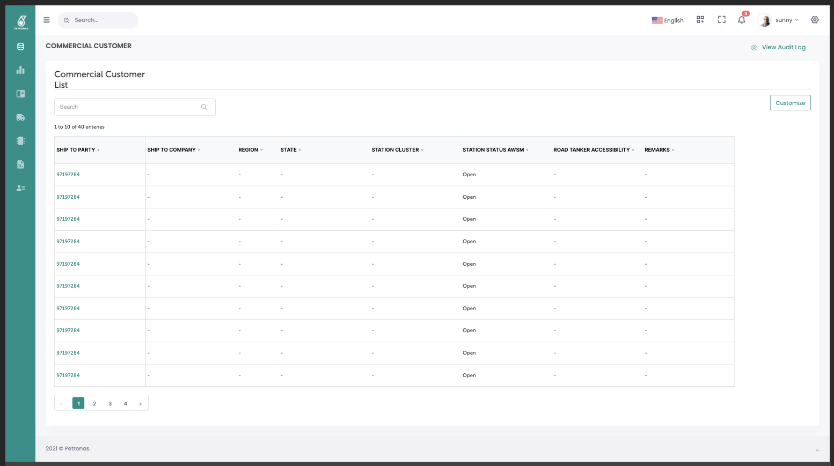
COMMERCIAL CUSTOMER – Main table
1. Replace header with Module Title + AWSM Logo (as in invision)
2. Main Table should be responsive and show 10 column as default.
3. Use icon, align bottom with entries (12pt from main table)
4. Please set a margin as in invision, right now they’re too close to the border
5. Make the scroll base clean and white instead of grey

Slide 25
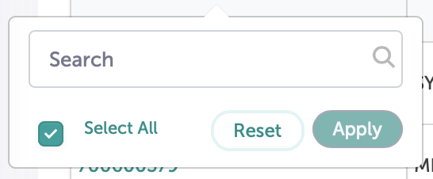
COMMERCIAL CUSTOMER – Dropdown Filter
1. Ensure the pop-up and arrow has similar border
2. Allow 16pt margin between icon and border
3. Ensure the checkbox and text is aligned

Slide 26
COMMERCIAL CUSTOMER – Side Menu
1. User Avatar and Profile will be here

Slide 27
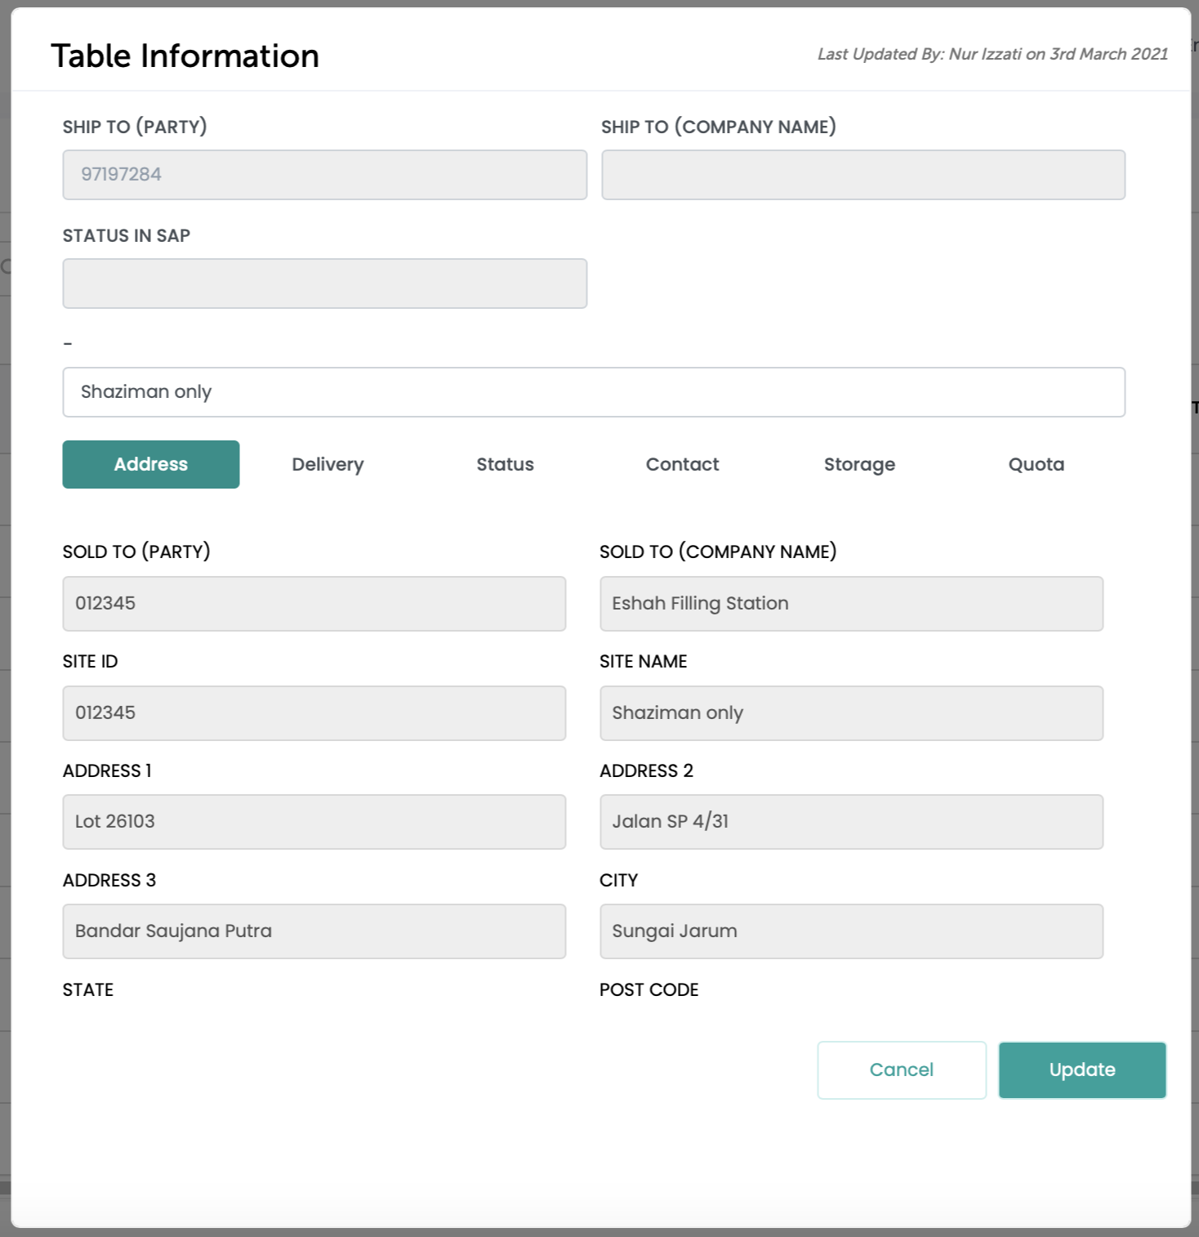
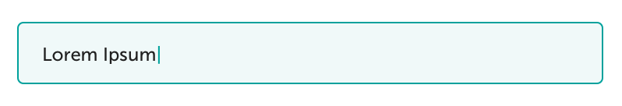
COMMERCIAL CUSTOMER– View Details
1. Ensure the gap is consistent
2. Need to follow active text fill (when clicked) as in DLS as shown below. You may also refer this link: Supervisor contact name https://projects.invisionapp.com/d/main?origin=v7#/console/21275876/449307379/preview?scrollOffset=4193
3. Tab design is not the same as invision (Must follow Design Language System)
4. Ensure text for un-editable data is in consistent color. (Refer “Ship to Party” text colour)
5. Looks floating, please ensure consistent distance (as in invision) throughout the whole design

Slide 28
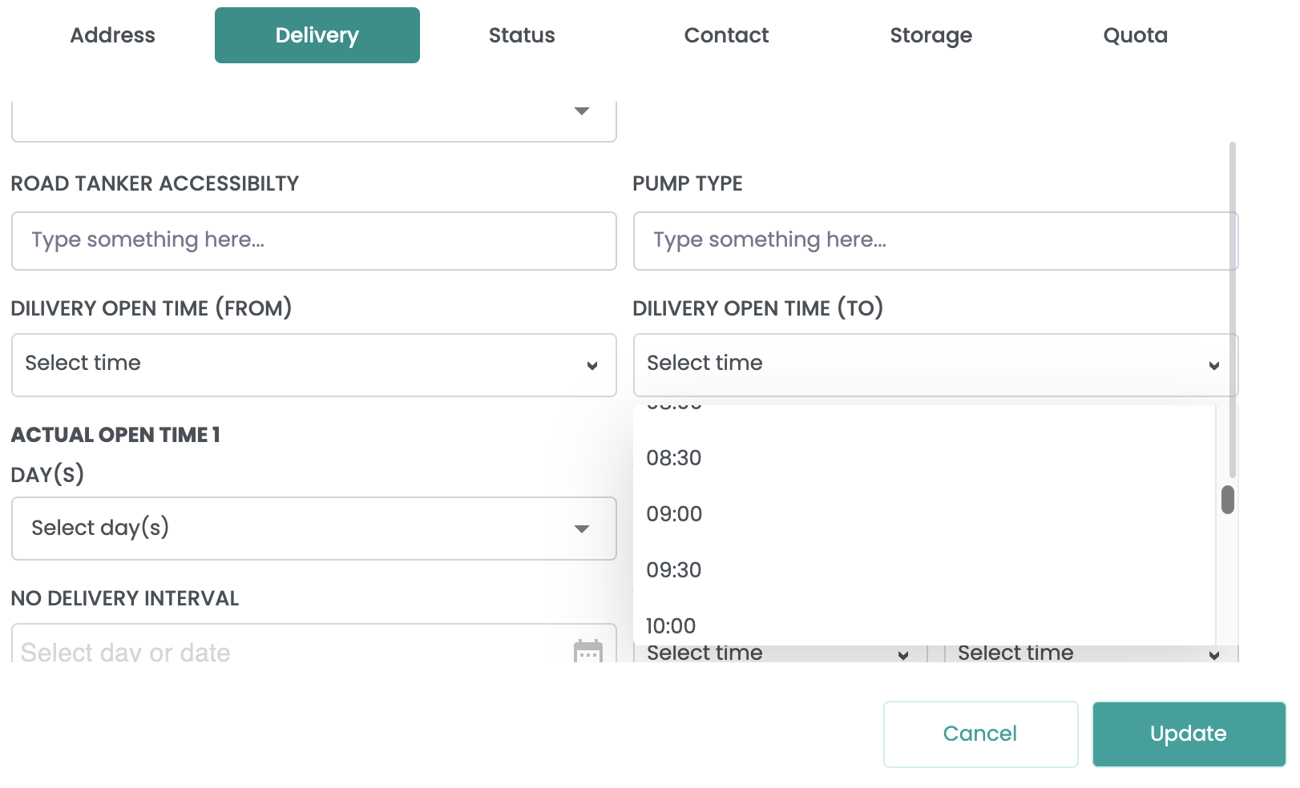
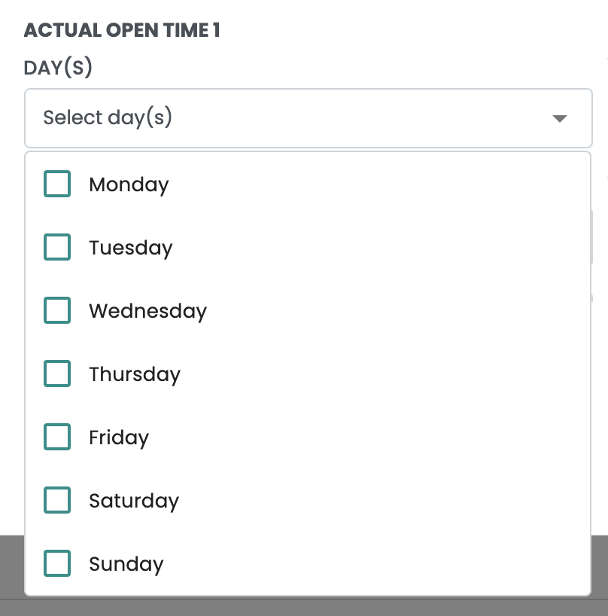
RETAIL CUSTOMER– View Details
1. Overlapping scroll and text field
2. Need to follow active text fill (when clicked) as in DLS as shown below. You may also refer this link: Supervisor contact name https://projects.invisionapp.com/d/main?origin=v7#/console/21275876/449307379/preview?scrollOffset=4193
3. Please reduce the shadow for dropdown, it looks dirty
4. Using different design for dropdown arrow, please make sure it’s consistent throughout the whole design
5. Please make sure checkbox component is consistent throughout the whole design

Slide 29
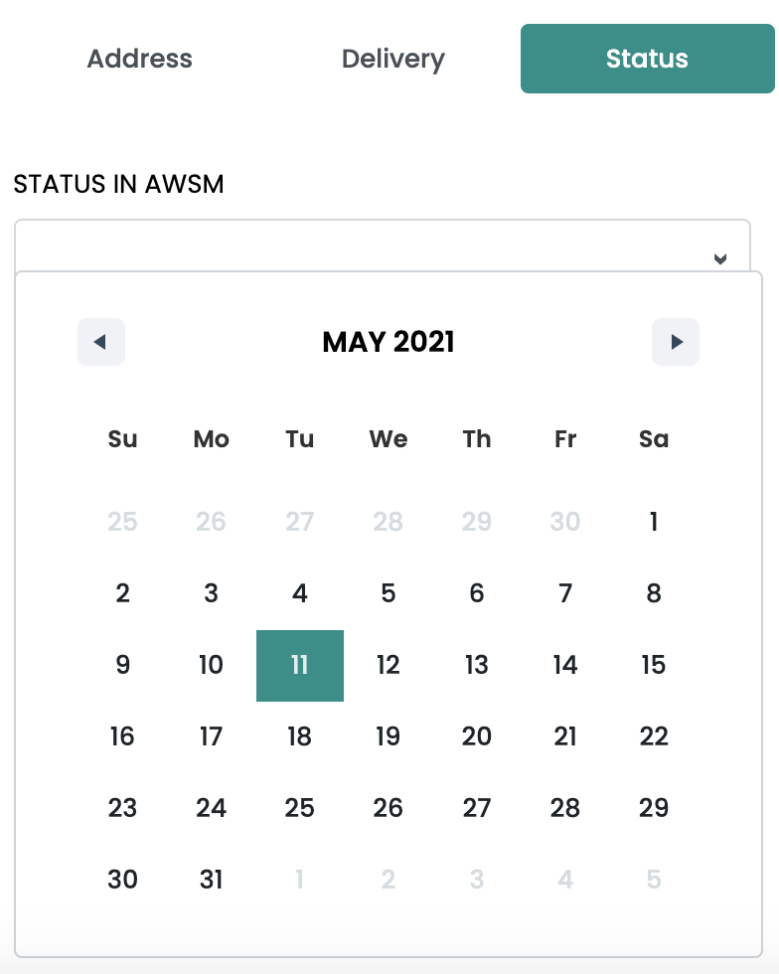
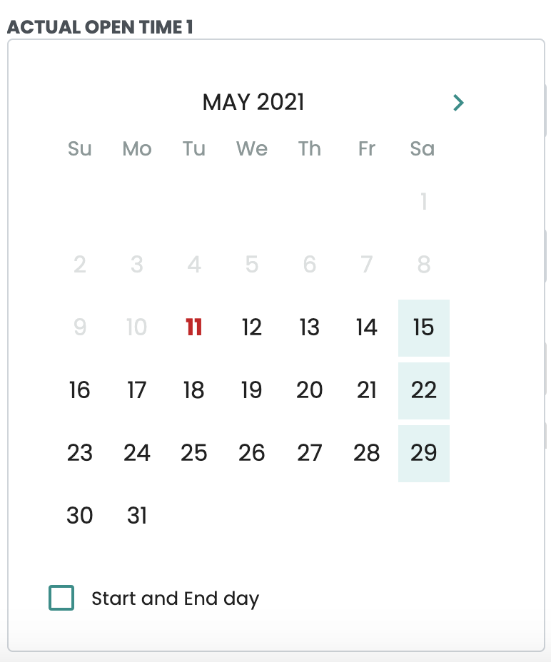
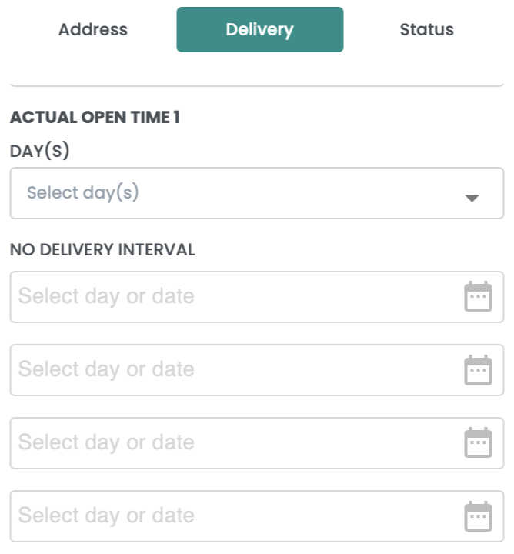
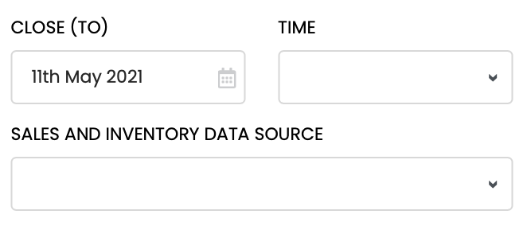
RETAIL CUSTOMER– View Details
1. Different design for calendar, please ensure consistency based on design in invision
2. Calendar should not cover/overlapped its own dropdown field, please make sure it appear either at the top or bottom.
3. Please highlight the day as well (in green) when day is picked.
4. Please make sure checkbox component is consistent throughout the whole design
5. Different icon for calendar, please ensure consistency based on design in invision

Slide 30
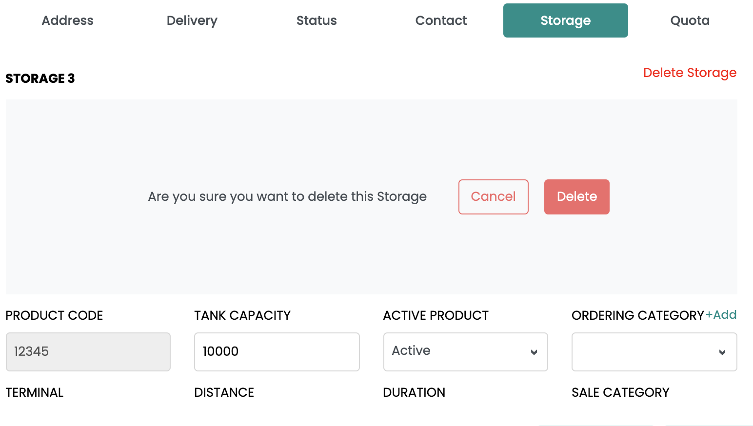
RETAIL CUSTOMER– View Details
1. Please makes sure Storage label and ‘delete storage’ is aligned
2. Delete confirmation should cover the storage details, refer invision.
3. ‘Add button’ is to close to the header. Please reduce spacing between text field to 8pt

Slide 31
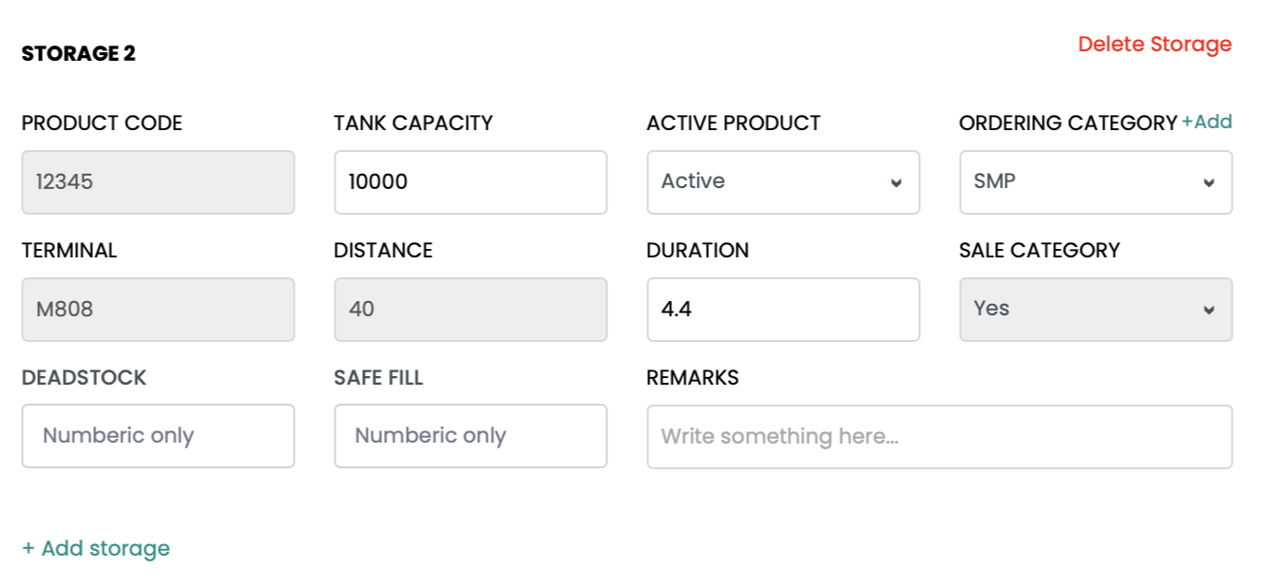
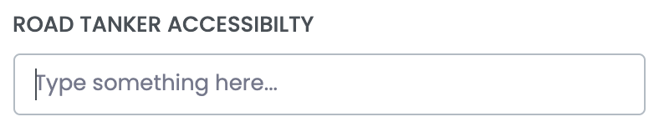
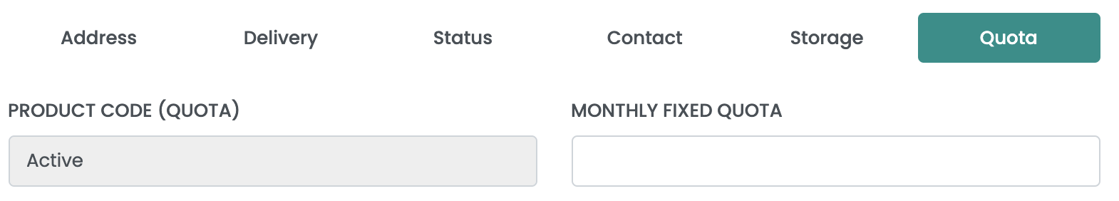
RETAIL CUSTOMER– View Details
3. Add separator line before ’Add Storage’ button. You may refer this link:
https://projects.invisionapp.com/d/main?origin=v7#/console/21275876/451028126/preview?scrollOffset=4544
2. Need to follow active text fill (when clicked) as in DLS as shown below. Apply throughout the whole design
You may refer this link: Supervisor contact name https://projects.invisionapp.com/d/main?origin=v7#/console/21275876/449307379/preview?scrollOffset=4193
2. Do not leave it blank, put command, refer excel by izzati

Slide 32
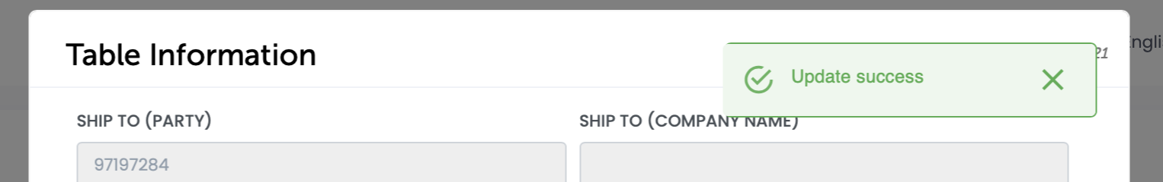
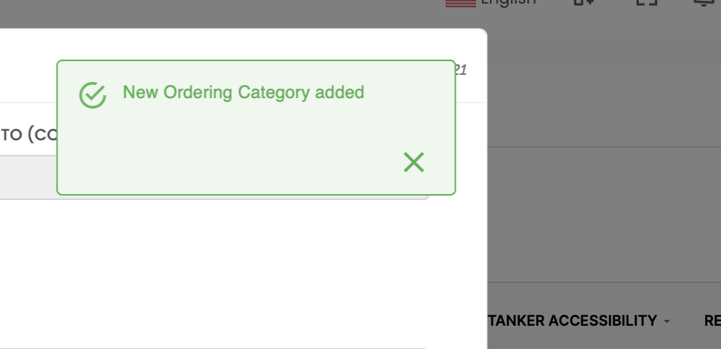
COMMERCIAL CUSTOMER – Missing Ui
COMMERCIAL CUSTOMER – View Details
1. Success notification should appear on the main screen.
1. Must follow DLS as in invision. Please fix the size too
Exit Confirmation for View/Amend details
Delete added new category
Please refer: https://projects.invisionapp.com/d/main?origin=v7#/console/21275876/449308883/preview?scrollOffset=822

Slide 33
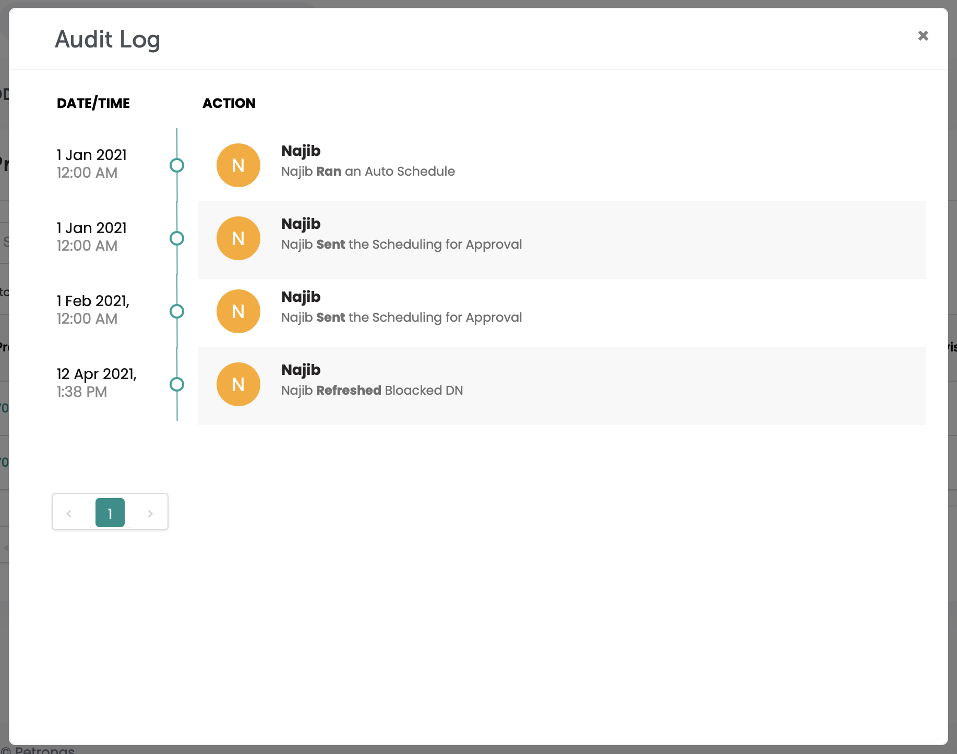
COMMERCIAL CUSTOMER – Audit Log
1. Please maintain the same margin left and right
2. Currently looks floating. Audit log should be dynamic with max of 10 activities per page, please make sure the distance between trail > pagination, pagination > bottom are consistent as in invision

Slide 34
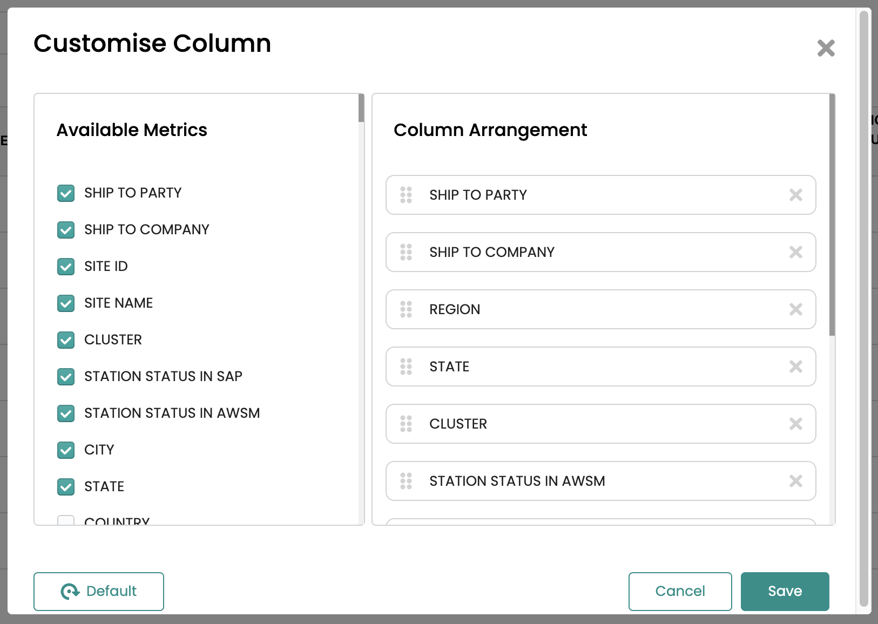
COMMERCIAL CUSTOMER – Customise Column
2. Remove this scroll
4.Apply the same scroll design as in main table with clean & white base
5. Too close to the bottom, please allow a consistent margin as in invision

Slide 35
Thank you for your passion!
Internal

